Slide 1


TeleSupervision in the Health Sciences
April 21, 2021
Lauren Tittley & Mariska Burger
School of Communication Sciences and Disorders
McGill University

Slide 2
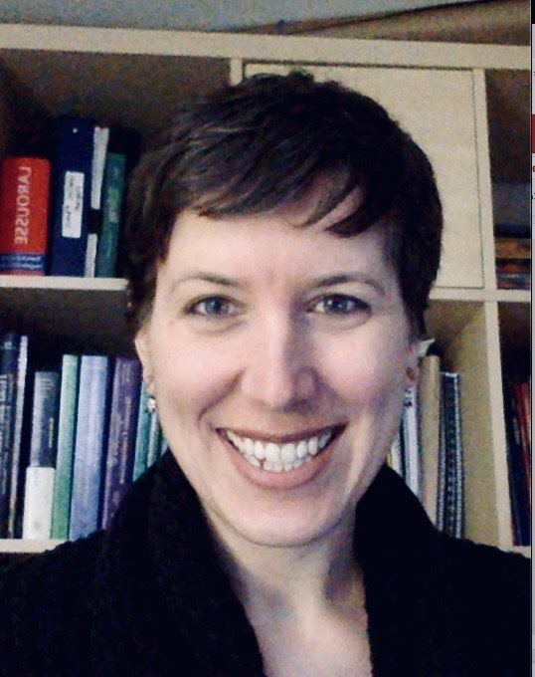
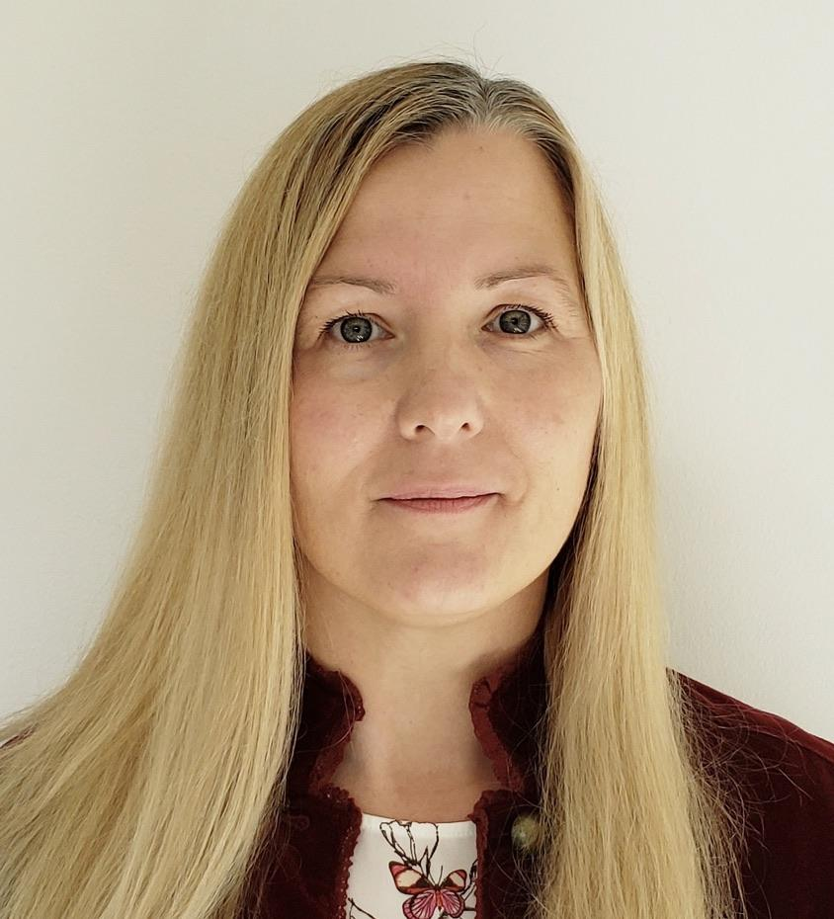
Introductions
Mariska Burger, SLP
Faculty Lecturer
Supervision & Special Projects
Lauren Tittley, SLP
Faculty Lecturer
Supervision & Special Projects

Slide 3
McGill University is situated on the traditional territory of the Kanien’kehà:ka, a place which has long served as a site of meeting and exchange amongst nations. We recognize and respect the Kanien’kehà:ka as the traditional custodians of the lands and waters on which we meet today.
Over the last few years, the SCSD has had the great fortune of working closely with the Kanien’kehà:ka community through the collaborative development of clinical placements within the Kahnawà:ke Education Center (KEC). We highly appreciate and value the contribution of KEC, and many members of the Kanien’kehà:ka community, to the clinical education of McGill SLP students.

Slide 4
Acknowledgements
Mary Hendrickson MSc RD
Caroline Storr MBA OT
Martha Visintin MSc PT
Dr. Sarah Mason Aud (C)

Slide 5
Outline
Definition & types of telesupervision
What does the research say?
Feedback from McGill supervisors & students
Critical elements to consider
How to “telesupervise”
  Planning
  During
  After
References & Resources

Slide 6
“Today’s medical professionals must be masters of different skills that are related to using digital devices or online solutions” and mastering those skills “is now a crucial skill set that all medical professionals require.”
- Medical Futurist Dr. Bertalan Meskó

Slide 7
Telesupervision
Telesupervision is a process whereby distant supervision is provided using electronic information and communication technologies.
(Chipchase et al. 2014)
Notes:
We should specify that this can be via video conferencing or phone (dieticians seem to do a lot of phone calls)
Nursing school (public health nursing line - our 811

Slide 8
Telesupervision Set-Ups
On Site |  | Supervisor + Client | Student + Client
Remote | Supervisor | Student | Supervisor
 | Student
 | Client
Hybrid model
Notes:
Highlight profession with setup

Slide 9
Clinical applications for stages with a telepractice/telesupervision component
Physio, Audiology: - In person assessment – remote follow-up and supervision
Physio, S-LP: In-person or virtual training with supervisor - Intervention run by students (remote or in person) – (in) direct remote supervision
Dietetics: Student at hospital – supervisor remote
OT, S-LP: elementary classroom intervention via telepractice, students remote, supervisor remote or on site
S-LP: Simucase
Dietetics: remote cooking classes – public health prevention
Meetings between Supervisors and Stage Coordinators
All parties remote & connecting via telepractice (multiple disciplines)

Slide 10
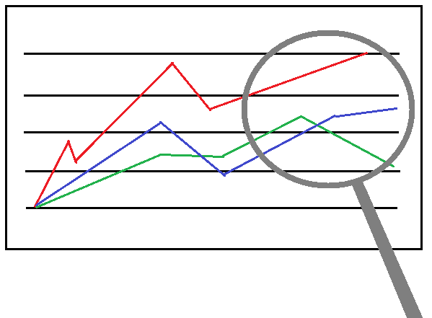
What does the research say?
Telesupervision is as effective as in-person supervision for:
Relationship between supervisor-supervisee
  Caveat: adding an in-person meeting helps
Quality of student learning
Development of student competence
Development of student clinician’s confidence
Student satisfaction with supervision/placement
Carlin (2013); Chapman (2011); Dudding (2004); Reese (2009); Salter (2020)
Notes:
Articles referenced looked at: SLP, OT, PT, Social Work/Counselling

Slide 11
What does the research say?
Advantages
Greater student autonomy
Flexibility re: location of supervisor (can be off-site)
Increase opportunities for placements in remote areas
More time efficient (e.g., less travel)
Supervision is more structured
Challenges
Technology/connectivity issues
Modeling and observing hands-on practices
Limited opportunities for students to interact with other professionals
More demanding on time (e.g., more time required to plan)
Supervision is more structured
Carlin (2013); Chapman (2011); Dudding (2004); Reese (2009)
Notes:
Our CEs feedback was very similar to that of the research, with the following additions in the challenges section:
Challenges : Giving students access to materials and charts, and some did find it a bit harder to develop a working relationship with their students.
Benefits
· More regular supervision
· Increased student independence
· Less travel time
· Collaboration with students to build telepractice resources
Challenges
· Building relationships
· Technological issues
· Access to materials/charts

Slide 12
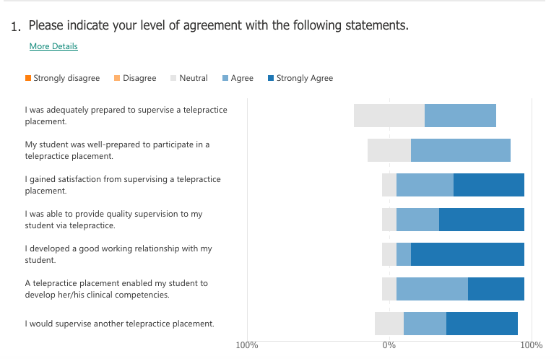
McGill SCSD
Summer 2020 – Supervisor Feedback

Slide 13
McGill Student Feedback
"Feels like I got to practice my clinical skills just as much. Helped me develop my adaptability and creativity maybe even more than an in-person placement."
"No commute, got to serve clients who otherwise might not get services, more flexible (i.e. could attend from out of town)".
"Not as much collegiality. Feelings of isolation. Differentiating work from life can be a challenge. There is always the temptation to continue working."
"The learning and clinical experience was on the same level as face-to-face placements."
"I felt disappointed about the placement not being in person, but realized my observational skills and communication skills developed rapidly."
"It provided me with a new perspective on therapy."

Slide 14








Learning in your student’s presence
Telepractice and telesupervision are new to A LOT of clinicians.
It’s ok (actually it’s great) to be learning something new in the presence of your students!
  models lifelong learning/professional development
  your student can help you acquire new skills, knowledge, resources
Identify a colleague/mentor/Coordinator of Clinical Education you can turn to for help.
We’re All in This Together!

Slide 15


Confidentiality
Consider a Student Confidentiality Agreement
  Must have a secure & private space to work in
  Must not save personal client information on own devices
Management of client files/client information
  Secure drive (e.g., D2, OneDrive for Business) for client files/charting
  Alternatively:
    Send confidential documents over secure email platform with password protection.
    Have students use pseudonyms or initials when documenting in a non-secure space (e.g., Google Drive).
  Check with your own IT department

Slide 16


Technology
Students must have reliable internet connection and technology (computer, webcam, microphone).
University programs may have supports in place for their students.
Technological problems do occur so back-up plans are important.
  Telephone connection in case of audio problems
  Back-up device in case of problems with computer/tablet
  Data in case of problems with internet/wi-fi

Slide 17
How to “tele-supervise”
Planning
(before)
Teaching/Supervising (during)
Evaluating/debriefing (after)
Factor in extra time

Slide 18

Planning
1. Orient learner
If student will be engaging in telepractice, verify level of experience.
Orient your student to:
  the telepractice platform used in your workplace
  the features you typically use with your clientele
  your workplace and colleagues

Slide 19
Planning
1. Orient learner cont'd
Consider providing a little more time for observation than you usually would
Inform your student about how you adapted/changed your practice for the clients you see via telepractice
  Setup of your sessions (e.g., Length/organization of sessions)
  Clinical activities (e.g., Test & material selection)
  Interpersonal Skills (e.g., Frequency of check-ins with patient on understanding)
  Selection of client (e.g., Less direct services for clients aged 0-3, but increased coaching services)

Slide 20
Planning
2. Discuss access to assessment and treatment materials
Physical and digital materials, particularly if student is off-site.
Check if the student has access to digital materials through their university.
Encourage students to find free online materials.
Students are fantastic at creating novel digital materials!
3. Review documentation practices

Slide 21
Planning
4. Organize logistics
Exchange phone numbers
Book specific times for case discussions and feedback
Think about breaks to go to the bathroom, screen breaks, sufficient time between session to get set up for new client, etc.
Telesupervision doesn't mean being online all day.

Slide 22
Planning
5. Create a positive learning environment
Clarify expectations
  Discuss student’s experience with telepractice.
  Discuss goals of the placement & consider adding some relating specifically to telepractice.
  Consider possible impact of telepractice on clinical skills.
  Regularly check in/review expectations.
Build rapport (must be done more intentionally)
  “Virtual coffee breaks” to get to know each other.
  Introduce students to your team if possible.
  If possible, arrange an in-person meeting.

Slide 23

During: managing the session
Connect with your student(s)
Review the session plan and specify the expectations.
Verify technology and discuss troubleshooting plan.
Discuss method of online feedback with student.
Notes:
Specify the expectations, I feel here we can talk about the setup the dieticians had... Who leads what part, will there be time in the session for clinician and student to talk confidentially etc.
Feedback examples jump in, private meeting, private chat, thumbs up
Mention that this is done before connecting with the client.
Interject verbally.
Use the private chat (ensure you select the student and not “everyone”).
Use the emojis (thumbs up) .
Consider impact on client distraction/need to intervene.

Slide 24

During: managing the session
2. Connect with the client
Introduce yourself and your students (if first session).
If you are observing and not actively participating, consider how you can limit distractions (e.g., turn off your camera and microphone.
Consider ways to privately conference with you student (e.g., client in waiting room, private chat).

Slide 25
During: managing the session
3. Your level of participation will vary.
As always, you may lead, co-lead, simply observe or supervise indirectly (not present).
4. Some clinical teaching strategies that transfer well to telesupervision:
Priming
Reflective Modeling
Teaching in the Patient’s Presence
Heidenreich et al., 2000

Slide 26

After: feedback
FEED
BACK
Very similar to in-person placements!
Schedule time specifically for feedback & case discussion.
  Involve your student in this planning
Discuss how students will spend their unsupervised time (e.g. prep, documentation etc.).
Let students know when you are available between sessions and how they can contact you.

Slide 27
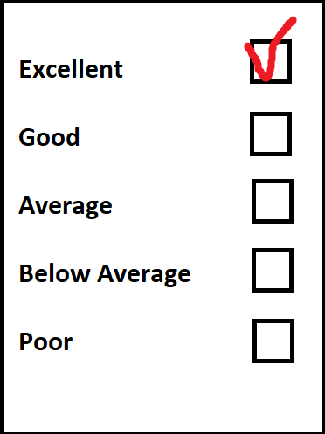
After: formal evaluation
Many clinical skills transfer to telepractice.
Most clinical skills are easy to evaluate via telesupervision.
Keep student’s level of clinical & technological competence in mind
  If new to telepractice, management of the technology can impact clinical performance/development of clinical competencies.
Consider explicitly evaluating telepractice specific skills.

Slide 28
Questions?
mariska.burger@mcgill.ca
lauren.tittley@mcgill.ca

Slide 29
Resources and References
Carlin, C. H., Boarman, K., Carlin, E., & Inselmann, K. (2013). The use of e-supervision to support speech-language pathology graduate students during student teaching practica. International Journal of Telerehabilitation, 5(2), 21–32. doi:10.5195/IJT.2013.6128
Chapman, R., Baker, S. B., Nassar-McMillian, S. C., & Gerler, E. R. (2011). Cybersupervision: Further examination of synchronous and asynchronous modalities in counseling practicum supervision. Counselor Education and Supervision, 50, 298–313. doi:10.1002/j.1556-6978.2011.tb01917.x
Chipchase, L., Hill, A., Dunwoodie, R., Allen, S., Kane, Y., Piper, K., & Russell, T. (2014). Evaluating telesupervision as a support for clinical learning: An action research project. International Journal of Practice‐based Learning in Health and Social Care,2(2), 40–53.
Davis-Maille, C., Belanger, R. (2020, July 20). Guidelines and Recommendations for Telesupervision of Telepractice Placements in Speech-Language Pathology – An Alternate Model of Clinical Education in Pandemic Times. SAC Communiqué. https://blog.sac-oac.ca/guidelines-and-recommendations-for-telesupervision-of-telepractice-placements-in-speech-language-pathology-an-alternate-model-of-clinical-education-in-pandemic-times/
Dudding, C. C., and Justice, L. M. (2004) ‘An e-supervision model: Videoconferencing as a clinical training tool’. Communication Disorders Quarterly 25 (3), 145-151. doi: 10.1177/15257401040250030501

Slide 30
Faculty Development Office (2020, July 13). Supervision Learners Providing Virtual Care Webinar. McGill University, Faculty of Medicine.
Heidenreich C, Lye P, Simpson D, Lourich BA. The search for effective and efficient ambulatory teaching methods through the literature. Pediatrics 2000; 105: 231–7.
Martin P, Kumar S, Lizarondo L. Effective use of technology in clinical supervision. Internet Interv 2017; 8: 35–39.
Nagarajan, S., McAllister, L., McFarlane, L., Hall, M., Schmitz, C., Roots, R.,Drynan,D., Avery, L., Murphy, S., & Lam, M. (2016). Telesupervision benefits for placements: Allied health students’ and supervisors’ perceptions. International Journal of Practice-Based Learning in Health and Social Care, 4(1), 16-27. https://doi.org/doi:10.18552/ijpblhsc.v4i1.326
Reese, R.J., Aldarondo, F., Anderson, C.R., et al., 2009. Telehealth in clinical supervision: a comparison of supervision formats. J. Telemed. Telecare 15 (7), 356–361.
Salter, C., Oates, R. K., Swanson, C., & Bourke, L. (2020). Working remotely: Innovative allied health placements in response to COVID-19. International Journal of Work-Integrated Learning, 2020(5), 587-600.

